Slide 1
Unit 5
Application Layer

Slide 2
Syllabus
Unit-5: Application Layer:
Client Server Model, Socket Interface, Domain Name System (DNS): Electronic Mail (SMTP), File Transfer (FTP), POP, Remote Logging, HTTP and WWW.

Slide 3
Client Server Model

Slide 4
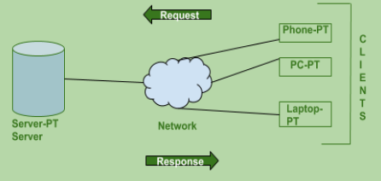
Client Server Model
Client: A client is a program that runs on the local machine requesting service from the server.
Server: A server is a program that runs on the remote machine providing services to the clients.
The client-server model describes how a server provides resources and services to one or more clients.
Examples of servers include web servers, mail servers, and file servers.
A single server can provide resources to multiple clients at one time.

Slide 5
Advantages and Disadvantages of Client Server Model
Advantages:
Centralized: Centralized back-up is possible in client-server networks.
Security: These networks are more secure as all the shared resources are centrally administered.
Performance: This increases the performance of the overall system.
Scalability: We can add a new node in a network at any time.
Disadvantage:
Traffic Congestion is a big problem in Client/Server networks.
When the server is down, then the client requests cannot be met.
Data packets may be modified during transmission.

Slide 6
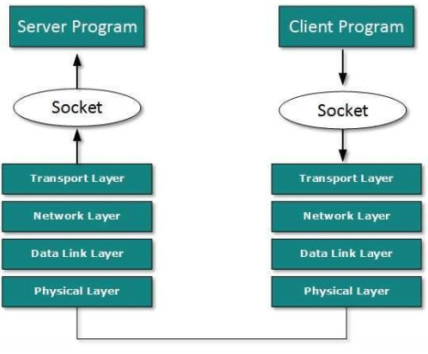
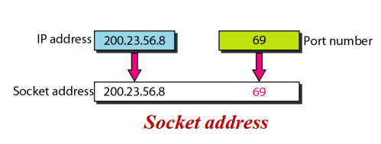
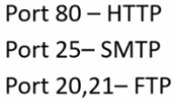
Socket Interface
A process sends messages into, and receives messages from the network through a software interface called Socket.
Socket is the interface between application layer and transport layer within the host.

Slide 7
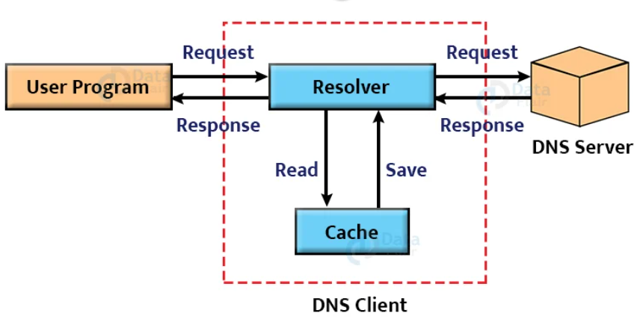
Domain Name System (DNS)
The Domain Name System (DNS) is a hierarchical naming system used by the Internet to translate human-readable domain names into their corresponding numerical IP addresses.
Properties of DNS:
The Domain Name System (DNS) works on Client Server model.
It uses UDP protocol for transport layer communication.
DNS uses hierarchical domain based naming scheme.
DNS uses UDP port 53

Slide 8
Domain Name System (DNS)
The steps involved in DNS Resolution are
Step-01:
A user program sends a name query to a library procedure called the resolver.
Step-02:
Resolver looks up the local domain name cache for a match.
If a match is found, it sends the corresponding IP Address back.
If no match is found, it sends a query to the local DNS server.
Step-03:
DNS server looks up the name.
If a match is found, it returns the corresponding IP Address to the resolver.
If no match is found, the local DNS server sends a query to a higher level DNS server.
This process is continued until a result is returned.
Step-04:
After receiving a response, the DNS client returns the resolution result to the application.

Slide 9
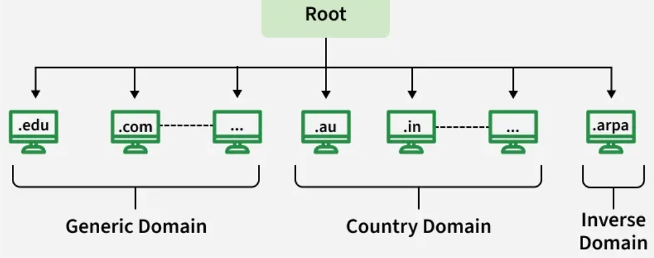
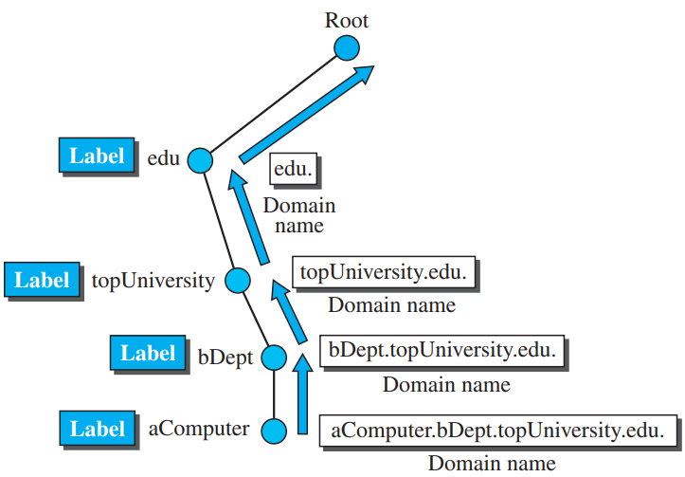
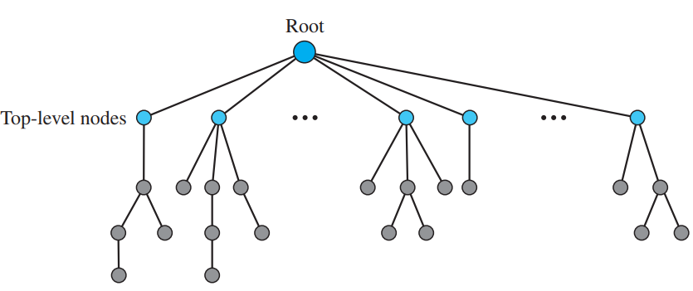
Domain name Space
The domain name space is divided into three different sections:
  Generic domains
  Country domains
  Inverse domain

Slide 10
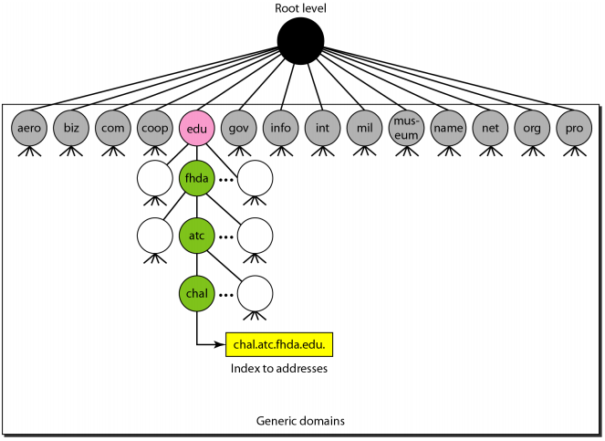
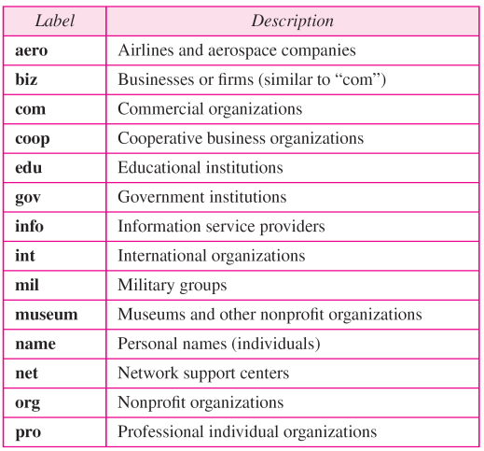
Generic domains
Each node in a tree defines the domain name, which is an index to the DNS database.
It uses usually three-character labels, and these labels describe the organization type.

Slide 11
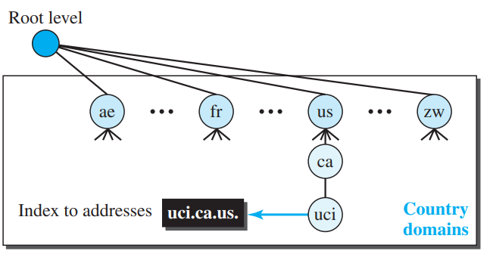
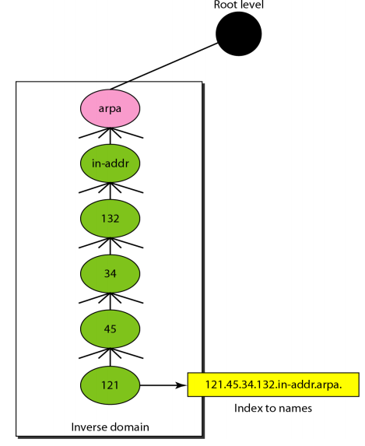
Country domains
Inverse domains
The format of country domain is same as a generic domain, but it uses two-character. (e.g., us for the United States).
These domains are used to map IP addresses back to domain names.
Used for reverse lookup (IP address -> domain name)
IPv4 uses in-addr.arpa

Slide 12
Application Layer Protocols
Simple Mail Transfer Protocol (SMTP)
File Transfer Protocol (FTP)
Post Office Protocol (POP)
Remote Logging
HTTP
WWW

Slide 13
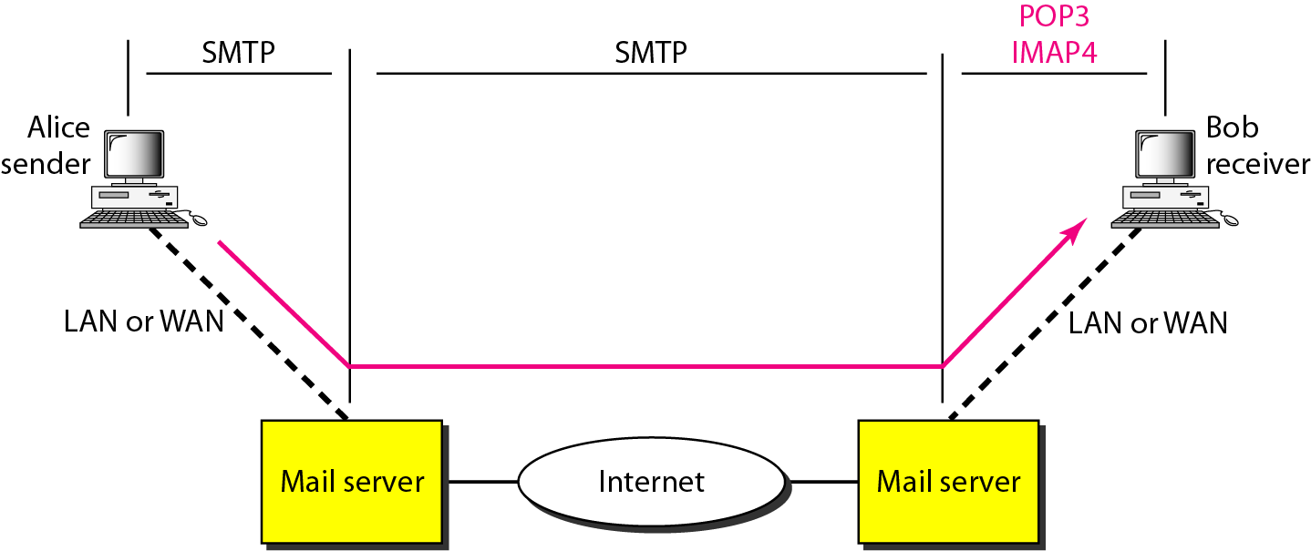
Electronic Mail : Simple Mail Transfer Protocol (SMTP)
One of the most popular Internet services is electronic mail (e-mail).
Simple Mail Transfer Protocol (SMTP) is a TCP/IP protocol used in sending and receiving e-mail.
It is typically used with POP3 or Internet Message Access Protocol (IMAP) to save messages in a server mailbox and download them periodically from the server for the user.

Slide 14
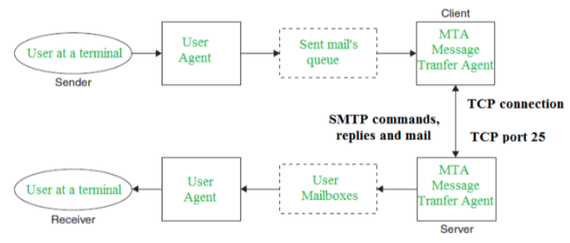
Component | Meaning
Sender | Person sending
Sender UA | Email application
Mail Queue | Waiting area for outgoing email
Sender MTA | Sends email between mail servers
TCP | Provides reliable connection
Port 25 | Traditional SMTP server-to-server port
SMTP | Protocol for sending/transferring email
Receiver MTA | Receives email
Mailbox | Stores received email
Receiver UA | Email application used to read mail
Receiver | Person receiving

Slide 15
User at a Terminal (Sender): The person composing the email using a mail application (e.g., Outlook, Thunderbird, webmail).
User Agent (Sender): The email client software that allows the sender to create, edit, and send emails.
It hands the outgoing email to the system’s mail queue.
Queue of Mail to Be Sent: A temporary storage area where outgoing emails wait before being processed by the mail server (Message Transfer Agent).
Message Transfer Agent (Client Side): The software responsible for sending emails across the network. It retrieves messages from the outgoing queue and communicates with the receiving server.
TCP Connection (Port 25): The client’s MTA opens a TCP connection to the server’s MTA on port 25. SMTP commands, responses, and mail data are exchanged over this connection.
Message Transfer Agent (Server Side): The receiving email server accepts the incoming SMTP connection. It processes the incoming email and stores it for the user.
User Mailboxes: The server stores the received messages in individual user mailboxes.
User Agent (Receiver): The email application used by the recipient to access the mailbox. It retrieves emails using protocols like POP3 or IMAP.
User at a Terminal (Receiver): The person reading the received email on their device.

Slide 16
Characteristics of SMTP
The main purpose of SMTP is used to set up communication rules between the servers to transmit an e-mail over the network.
It is an application layer protocol.
SMTP uses TCP at the transport layer.
SMTP uses TCP port no. 25.
SMTP is a connection-oriented protocol.
SMTP is a pure text-based protocol. It can only handle message containing text, but cannot transfers other data like image, audio, and video.
Multipurpose Internet Email Extension (MIME) extended the limited capabilities of email. MIME was specially designed for SMTP to send and receive graphics, audio, and video files in the message.

Slide 17
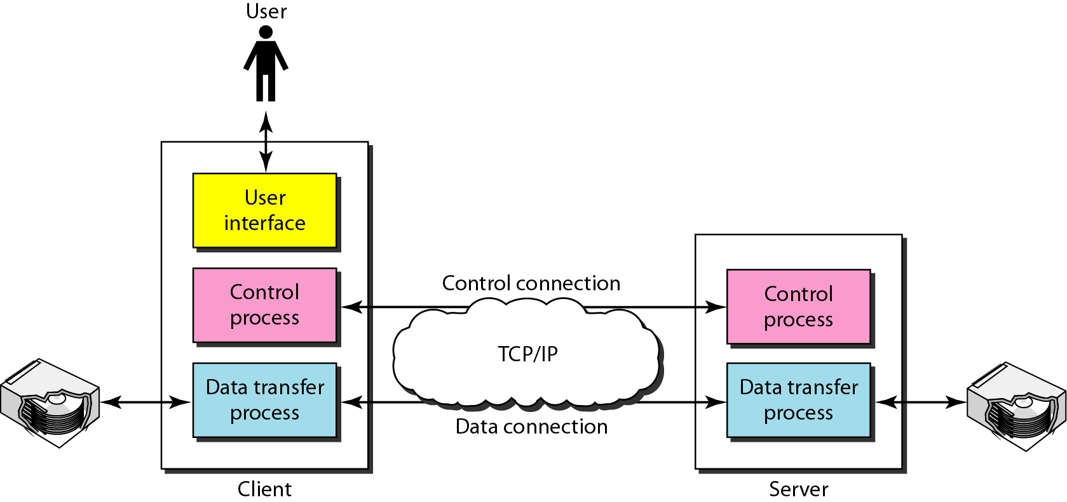
File Transfer Protocol (FTP)
Transferring files from one computer to another is one of the most common tasks expected from a networking or internetworking environment.
FTP is a standard internet protocol provided by TCP/IP used for transmitting the files from one host to another.
The well-known port 21 is used for the control connection and the well-known port 20 for the data connection.
Two systems may have different file conventions. Two systems may have different ways to represent text and data. Two systems may have different directory structures.
FTP protocol overcomes these problems by establishing two connections between hosts. One connection is used for data transfer, and another connection is used for the control connection.

Slide 18
Advantages of FTP:
Speed: One of the biggest advantages of FTP is speed.
Efficient: It is more efficient as we do not need to complete all the operations to get the entire file.
Security: To access the FTP server, we need to login with the username and password. Therefore, we can say that FTP is more secure.
Disadvantages of FTP:
The size limit of the file is 2 GB that can be sent by FTP.
It also doesn't allow you to run simultaneous transfers to multiple receivers.
It is not compatible with every system.

Slide 19
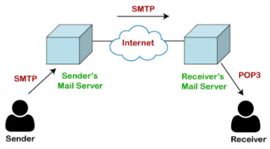
Post Office Protocol (POP)
The POP protocol is used by SMTP as a message transfer agent.
The message is sent from the recipient server to the actual server with the help of the Message Access Agent.
The Message Access Agent contains two types of protocols, i.e., POP3 and IMAP.
POP3: A protocol used to download emails from a mail server to a user's device.
IMAP: A protocol used to access and manage emails on the mail server while synchronizing them across devices.
What is POP3?
The POP3 is a simple protocol and having very limited functionalities.
In the case of the POP3 protocol, the POP3 client is installed on the recipient system while the POP3 server is installed on the recipient's mail server.

Slide 20
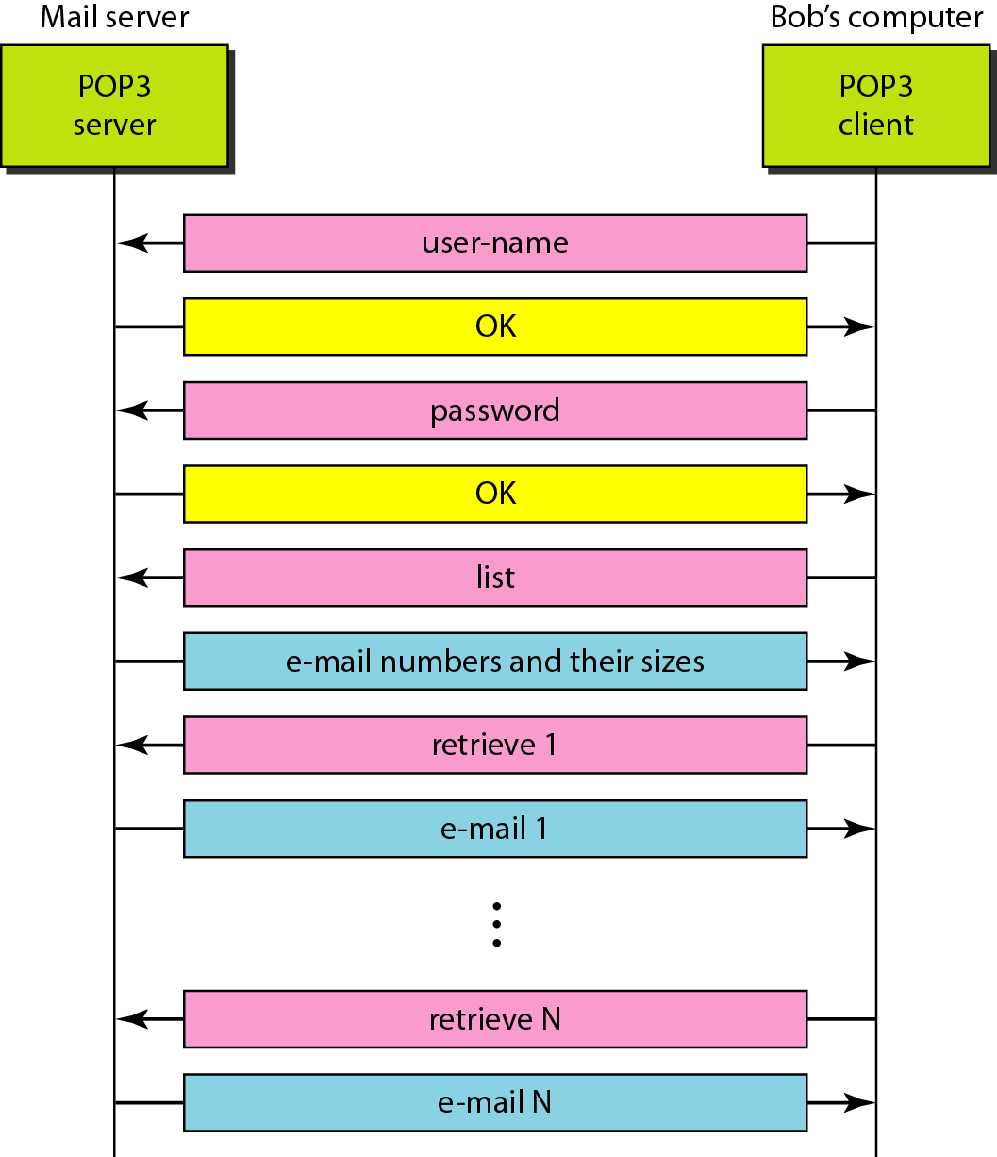
The exchange of commands and responses in POP3
Post Office Protocol, version 3 (POP3) is simple but limited in functionality.
The client POP3 software is installed on the recipient computer; the server POP3 software is installed on the mail server.
Mail access starts with the client when the user needs to download its e-mail from the mailbox on the mail server.
The client opens a connection to the server on TCP port 110.
It then sends its user name and password to access the mailbox.
The user can then list and retrieve the mail messages, one by one.

Slide 21
Advantages of POP:
It allows the users to read the email offline.
It provides easy and fast access to the emails as they are already stored on our PC.
There is no limit on the size of the email which we receive or send.
It requires less server storage space as all the mails are stored on the local machine.
It is easy to configure and use.
Disadvantages of POP:
Since all the attachments are stored on your local machine, there is a high risk of a virus attack.
The email folder which is downloaded from the mail server can also become corrupted.
The mails are stored on the local machine, so anyone who sits on your machine can access the email folder.

Slide 22
POP | IMAP
The full form of POP is Post Office Protocol | The full form of The full form of IMAP is Internet Message Access Protocol
POP is used to download emails from a mail server to the user's device. | IMAP is used to access and manage emails directly on the mail server.
POP generally downloads emails to the user's device and may remove them from the server. | IMAP normally keeps emails on the server and synchronizes them with the user's devices.
POP is more suitable when emails are mainly accessed from one device. | IMAP is more suitable when emails are accessed from multiple devices.
POP does not provide full synchronization of email status across devices. | IMAP synchronizes actions such as reading, deleting, and organizing emails across devices.
POP commonly uses port 110 for unencrypted communication. | IMAP commonly uses port 143 for unencrypted communication.
POP uses port 995 for secure communication. | IMAP uses port 993 for secure communication.

Slide 23
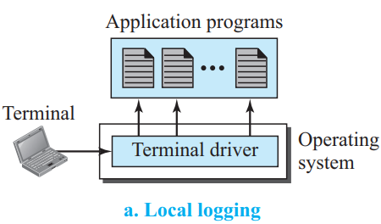
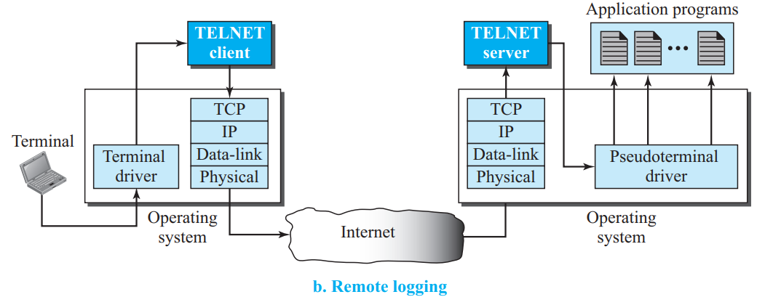
Local and Remote Log-in
TELNET is a general purpose client/server application program.
When a user logs into a local timesharing system, it is called local log-in.

Slide 24
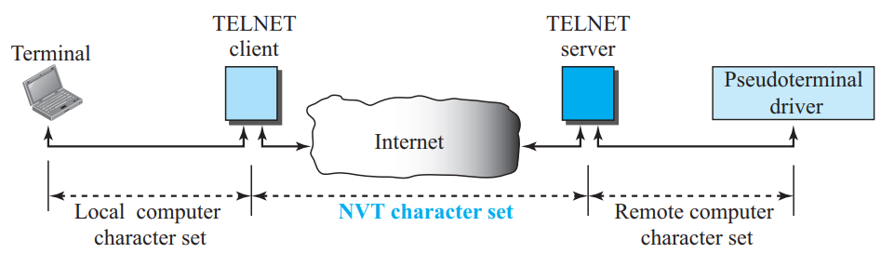
Remote Log-in
When a user wants to access an application program or utility located on a remote machine, it is called remote logging. Here the TELNET client and server programs come into use.
The user sends the keystrokes to the terminal driver where the local operating system accepts the characters but does not interpret them.
The characters are sent to the TELNET client, which transforms the characters into a universal character set called Network Virtual Terminal (NVT) characters and delivers them to the local TCP/IP stack.

Slide 25
Remote Log-in
The commands or text, in NVT form, travel through the Internet and arrive at the TCP/IP stack at the remote machine. Here the characters are delivered to the operating system and passed to the TELNET server, which changes the characters to the corresponding characters understandable by the remote computer.
However, the characters cannot be passed directly to the operating system because the remote operating system is not designed to receive characters from a TELNET server; it is designed to receive characters from a terminal driver.
The solution is to add a piece of software called a pseudoterminal driver, which pretends that the characters are coming from a terminal. The operating system then passes the characters to the appropriate application program.

Slide 26
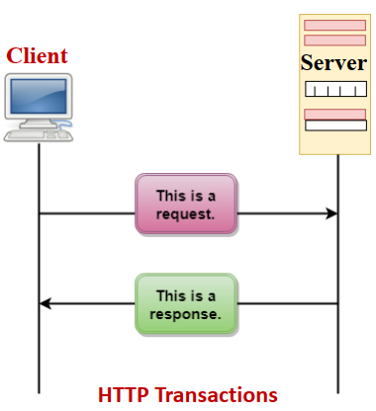
Hypertext Transfer Protocol (HTTP)
The Hypertext Transfer Protocol (HTTP) is a protocol used mainly to access data on the World Wide Web (WWW).
HTTP functions as a combination of FTP and SMTP.
HTTP uses the services of TCP on well-known port 80.

Slide 27
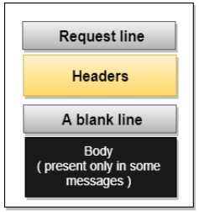
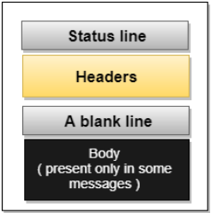
Types of HTTP Messages
HTTP messages are of two types: request and response. Both the message types follow the same message format.
Request Message: The request message is sent by the client that consists of a request line, headers, and sometimes a body.
Response Message: The response message is sent by the server to the client that consists of a status line, headers, and sometimes a body.

Slide 28
Characteristics of HTTP
It is a protocol used to access the data on the World Wide Web (WWW).
The HTTP protocol can be used to transfer the data in the form of plain text, hypertext, audio, video, and so on.
This protocol is known as Hyper Text Transfer Protocol because of its efficiency that allows us to use in a hypertext environment where there are rapid jumps from one document to another document.
HTTP is similar to the FTP as it also transfers the files from one host to another host.
HTTP is used to carry the data in the form of MIME-like format.

Slide 29
Types of HTTP
HTTP can use non-persistent or persistent connections between a client (web browser) and a web server.
1. Non-Persistent HTTP Connection: In a non-persistent connection, the TCP connection is closed after one object is transferred.
2. Persistent HTTP Connection: In a persistent connection, the same TCP connection remains open and can be used to transfer multiple objects.
Non-Persistent | Persistent
Connection closes after each object | Connection can remain open for multiple objects
New TCP connection is needed for each object | Same TCP connection can be reused
More connection-establishment overhead | Less overhead
Higher delay for webpages with many objects | Lower delay
HTTP/1.0 commonly used this approach | HTTP/1.1 commonly uses persistent connections

Slide 30
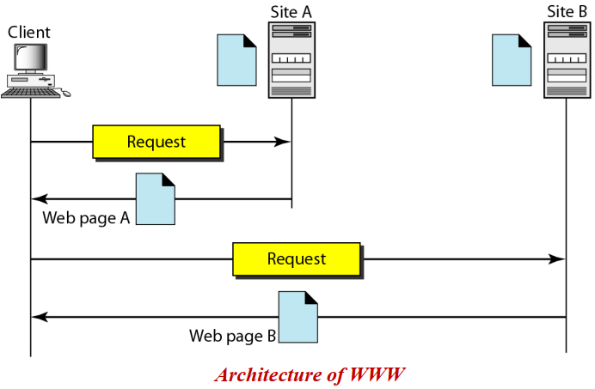
World Wide Web (WWW)
WWW is a method of browsing all the online data present on the Internet.
The users can access the large universe of documents present on different websites from any corner of the world.

Slide 31
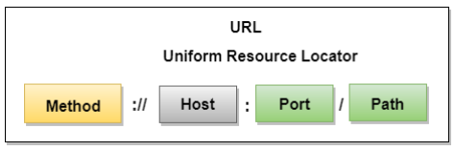
Uniform Resource Locator (URL)
A client that wants to access the document in an internet, the HTTP uses the concept of Uniform Resource Locator (URL). The URL is a standard way of specifying any kind of information on the internet.
The URL defines four parts: method, host computer, port, and path.
Method: The method is the protocol used to retrieve the document from a server. For example, HTTP.
Host: The host is the computer where the information is stored
Port: The URL can also contain the port number of the server.
Path: Path is the path name of the file where the information is stored.
https://www.cgu-odisha.ac.in/
→ Method: https | Host: www.cgu-odisha.ac.in | Port: 443 (default) | Path: /

Slide 32
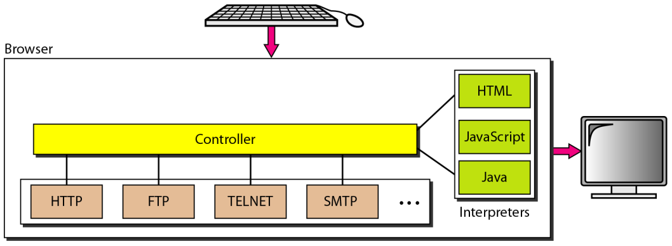
Client (Browser)
A variety of vendors offer commercial browsers that interpret and display a web page, and all of them use nearly the same architecture.
Each browser usually consists of three parts: a controller, client protocols, and interpreters.

Slide 33
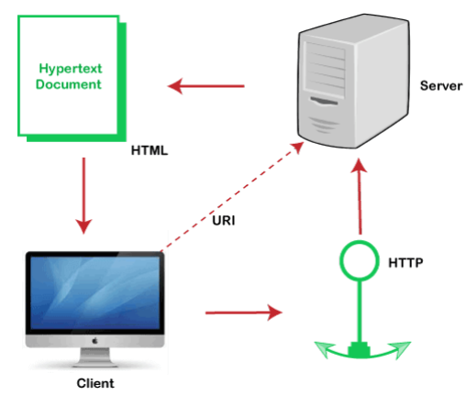
World Wide Web (WWW)
WWW is created on the basic model of client-server concept and hypertext data objects.
This initial concept of WWW represented in the HTTP Protocol (with a version of 0.9) and HTML applications (with a version of 1.0).
It based on a client-server model.

Slide 34
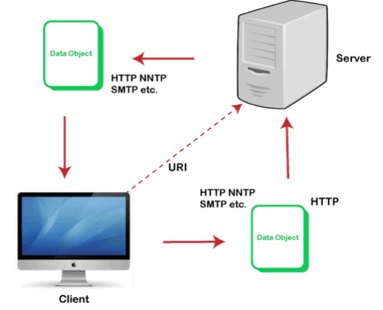
World Wide Web (WWW)
Advanced World-Wide Web Model
The current WWW model is very interactive but is also designed on a client-server concept.
The latest model is a generic resource exchange-based approach.
The latest model allows the client to post data to the server.

